Slide 1

Introduction into fMRI analysis. PsyMsc4 (Goethe 2022).
Inference II.
Session-4
Javier Ortiz-Tudela and Francesco Pupillo

Slide 2
Recap of last week
General recap.
Beta estimates cannot be interpreted directly.
T and F contrasts can be used to compare conditions.
Beware of contrasts against implicit baseline.
Contrast vectors are widely used and powerful when we have complex comparsions.
When designing an experiment, always chose an appropriate baseline.
1 -1 0

Slide 3
Functional MRI. Group-level analysis.
We have obtained contrast maps for each participant in our study. These contrast maps contain the values for each participant that correspond to our contrast vectors. Namely, the differences between conditions (in the directions specified by the vectors).
Similar as for a behavioral study, now we would want to see how consistent are those differences across the entire sample.
1 -1 0

Slide 4
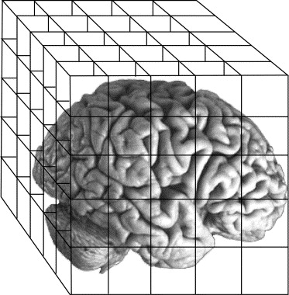





Functional MRI. Group-level analysis.
What are group-level analysis?
Comparison with a (rather) equivalent process to understand the rationale of the steps that we have done.
Behavioral
fMRI
Trials
Runs
Participants
(...)
(...)
Participants
(...)
(...)
Group
Group

Slide 5
Functional MRI. Group-level analysis.
What are group-level analysis?
Comparison with a (rather) equivalent process to understand the rationale of the steps that we have done.
Behavioral
fMRI
Trials
Runs
mean()
glm()
Participants
(...)
(...)
Participants
(...)
(...)
T test()
T test()
Group
Group

Slide 6
Functional MRI. Group-level analysis.
Quick note: Different names for the same (conceptual) steps on different packages.
 | FSL | SPM
Subjects | 1st level | 1st level
Runs | 2nd level
Group | 3rd level | 2nd level

Slide 7
Functional MRI. Group-level analysis.
So how do we do this? Back to RTs...
Participants / Conditions | Congruent (ms) | Incongruent (ms) | Congruity effect (ms)
1 | 750 | 889 | 139
2 | 322 | 569 | 247
3 | 477 | 789 | 312
4 | 566 | 865 | 299
(...) | (...) | (...) | (...)

Slide 8
Functional MRI. Group-level analysis.
So how do we do this? Back to RTs...
We can take these values and run T test against zero.
We will get a T value.
Participants / Conditions | Congruent (ms) | Incongruent (ms) | Congruity effect (ms)
1 | 750 | 889 | 139
2 | 322 | 569 | 247
3 | 477 | 789 | 312
4 | 566 | 865 | 299
(...) | (...) | (...) | (...)
QUESTION:
What will this test tell us?

Slide 9
Functional MRI. Group-level analysis.
What if we do this in one voxel?
Participants / Conditions | Congruent | Incongruent | Congruity effect
1 | 1750 | 889 | -861
2 | 2322 | 2569 | 247
3 | -477 | -789 | -312
4 | 638 | 1556 | 918
(...) | (...) | (...) | (...)

Slide 10
Functional MRI. Group-level analysis.
We can take these values and run T test against zero.
We will get a T value.
What if we do this in one voxel?
Participants / Conditions | Congruent | Incongruent | Congruity effect
1 | 1750 | 889 | -861
2 | 2322 | 2569 | 247
3 | -477 | -789 | -312
4 | 638 | 1556 | 918
(...) | (...) | (...) | (...)
QUESTION:
What will this test tell us?

Slide 11
Functional MRI. Group-level analysis.
We can take these values and run T test against zero.
We will get a T map.
And if we run it in all the voxels in the brain….?
Participants / Conditions | Congruent | Incongruent | Congruity effect
1 | 1750 | 889 | -861
2 | 2322 | 2569 | 247
3 | -477 | -789 | -312
4 | 638 | 1556 | 918
(...) | (...) | (...) | (...)

Slide 12
Functional MRI. Group-level analysis.
We can take these values and run T test against zero.
We will get a T map.
And if we run it in all the voxels in the brain….?
Participants / Conditions | Congruent | Incongruent | Congruity effect
1 | 1750 | 889 | -861
2 | 2322 | 2569 | 247
3 | -477 | -789 | -312
4 | 638 | 1556 | 918
(...) | (...) | (...) | (...)

Slide 13
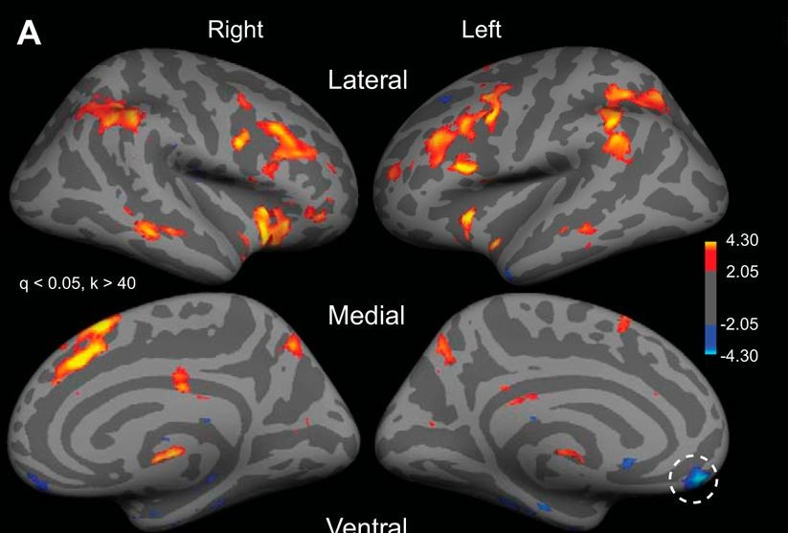
Functional MRI. Group-level analysis.
We can take these values and run T test against zero.
We will get a T map.
And if we run it in all the voxels in the brain….?
Participants / Conditions | Congruent | Incongruent | Congruity effect
1 | 1750 | 889 | -861
2 | 2322 | 2569 | 247
3 | -477 | -789 | -312
4 | 638 | 1556 | 918
(...) | (...) | (...) | (...)
So… activation maps are not activity maps per se: they are Statistical Parametric Maps (SPM) -T values in this case-.

Slide 14
Inference II.
Interim recap.
First level analysis take in raw BOLD signals and produce beta maps.
In a univariate contrast analysis, we subtract beta maps for each of our conditions from one another to obtain contrast maps.
Contrast maps are brought to a Second level (Third level in FSL) to aggregate across subjects.
Activation maps are actually statistical parametric maps.

Slide 15
Functional MRI. Group-level analysis.
QUESTION:
Why is not the entire brain colored?
Hint

Slide 16
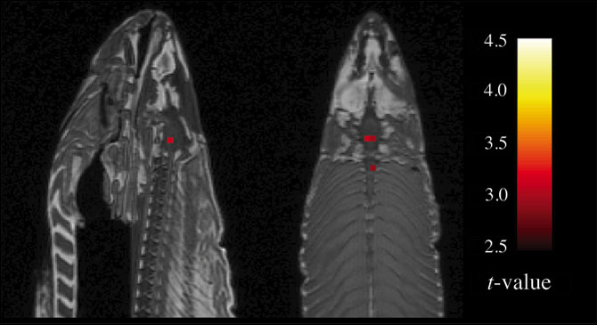
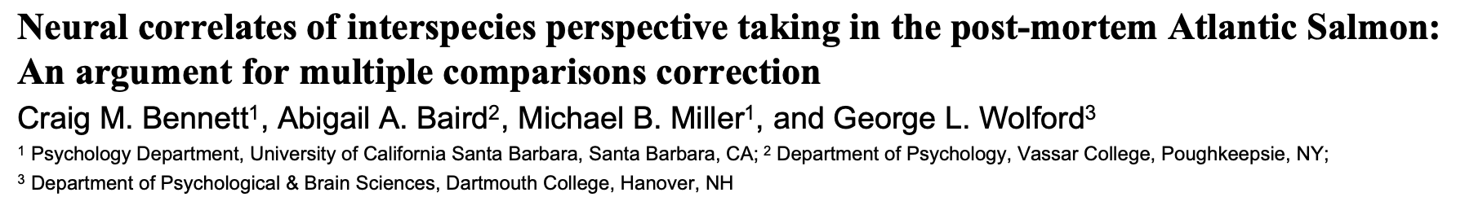
Functional MRI. Group-level analysis.
Enter: The dead salmon and MCC.

Slide 17
Functional MRI. Group-level analysis.
Multiple comparison problem:
A standard MNI brain has over 260,000 voxels.
Running a T test on every voxels implies running over 260,000 tests.
QUESTION:
What is the implication of this huge number of tests for our statistical inferences?

Slide 18
Functional MRI. Group-level analysis.
Multiple comparison correction:
Bonferroni.
False Discovery Rate (peak level. For a nice visualization of the procedure see https://andysbrainbook.readthedocs.io/en/latest/fMRI_Short_Course/fMRI_Appendices/Appendix_A_ClusterCorrection.html#appendix-a-clustercorrection)
False Discovery Rate (cluster level).

Slide 19
Functional MRI. Group-level analysis.
Bonferroni correction.
Corrected alpha = alpha / number of tests.
QUESTION:
Do you spot any problems with this type of correction?

Slide 20
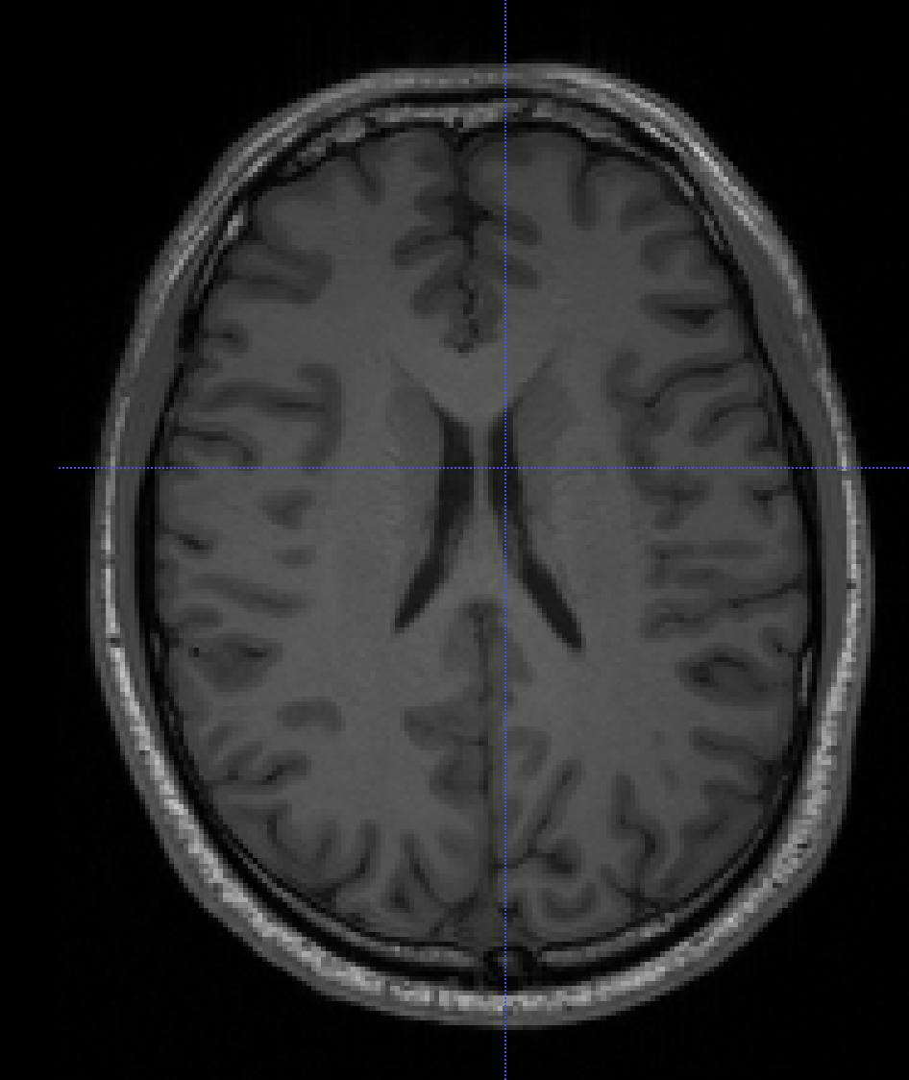
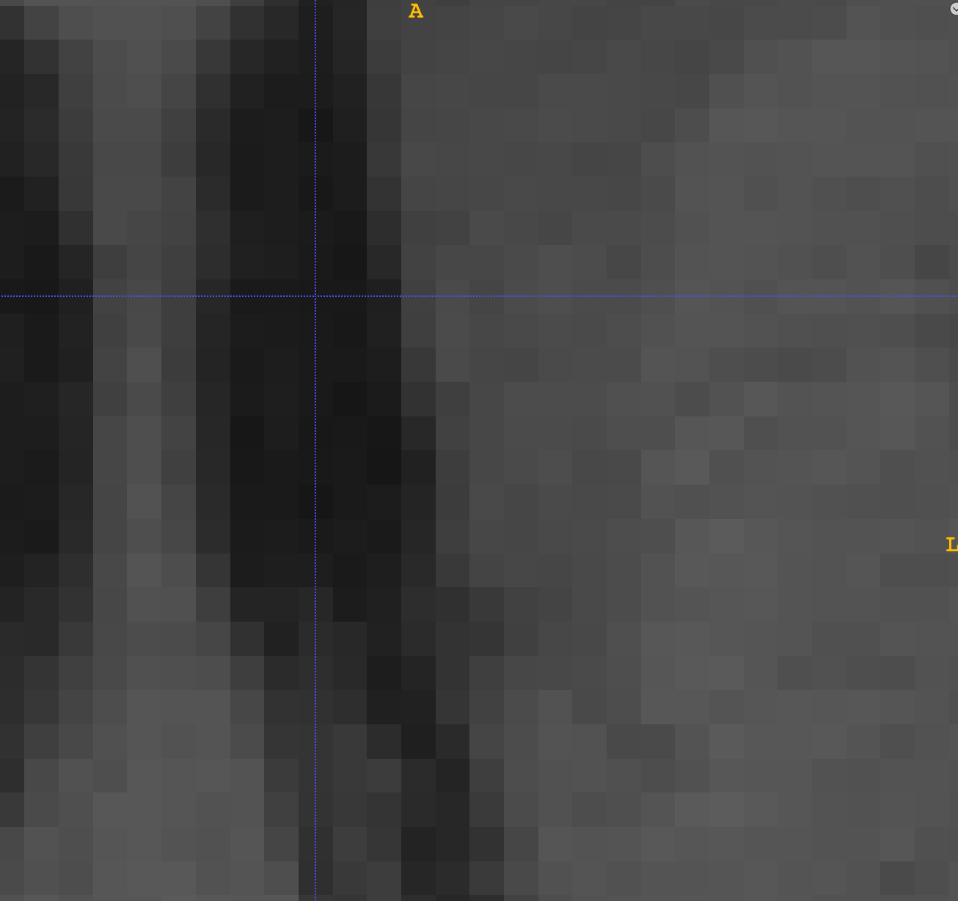
Functional MRI. Group-level analysis.
Bonferroni correction.
Corrected alpha = alpha / number of tests.

Slide 21
Functional MRI. Group-level analysis.
Multiple comparison correction:
Bonferroni.
FDR (peak level. For a nice visualization of the procedure see https://andysbrainbook.readthedocs.io/en/latest/fMRI_Short_Course/fMRI_Appendices/Appendix_A_ClusterCorrection.html#appendix-a-clustercorrection)

Slide 22
Functional MRI. Group-level analysis.
Multiple comparison correction:
Bonferroni.
FDR (peak level. For a nice visualization of the procedure see https://andysbrainbook.readthedocs.io/en/latest/fMRI_Short_Course/fMRI_Appendices/Appendix_A_ClusterCorrection.html#appendix-a-clustercorrection)
FDR (cluster level). What is the minimum cluster size that we are going to consider relevant?

Slide 23
Functional MRI. Group-level analysis.
Multiple comparison correction:
Bonferroni.
FDR (peak level. For a nice visualization of the procedure see https://andysbrainbook.readthedocs.io/en/latest/fMRI_Short_Course/fMRI_Appendices/Appendix_A_ClusterCorrection.html#appendix-a-clustercorrection)
FDR (cluster level). What is the minimum cluster size that we are going to consider relevant?
Random Field Theory (RFT). Not covered here.

Slide 24
Inference II.
General recap.
First level analysis take in raw BOLD signals and produce beta maps.
In a univariate contrast analysis, we subtract beta maps for each of our conditions from one another to obtain contrast maps.
Contrast maps are brought to a Second level (Third level in FSL) to aggregate across subjects.
Activation maps are actually thresholded statistical parametric maps.
Thresholding is done to account for the multiple comparison problem.
Bonferroni is usually too-strict and fails to take into account spatial correlation of BOLD signal.
FDR can help us obtain a good balance between specificity and sensitivity.

